Slide 1
Interreg - IPA CBC Bulgaria – Serbia Programme CCI: 2014TC16I5CB007
Projects proposed for financing
First Call for proposals

Slide 2
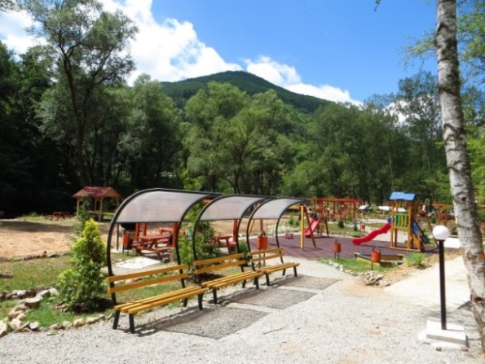
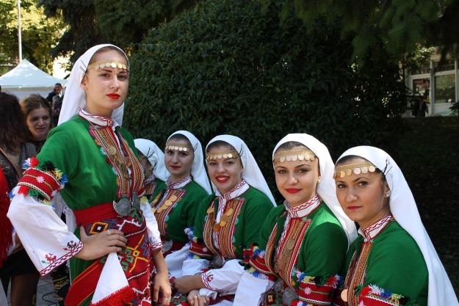
Priority Axis 1
Sustainable Tourism
Specific objective 1.1: Tourist Attractiveness;
Specific objective 1.2: Cross-Border Touristic Product;
Specific objective 1.3: People-To-People Networking.

Slide 3
Projects proposed for funding under Priority Axis 1
Financial allocation 2015 - 2017

Slide 4
Specific Objective 1.1
Reference No: CB007.1.11.095
Title: “Promotion of the tourist attractions through interactive exhibition of cultural - historical heritage of the cross-border region”
Brief description: The project aims to use the cultural heritage of Pirdop and Palilula as an opportunity to increase attractiveness of the region through delivery of equipment for interactive exhibition of cultural/historical heritage in Pirdop and Palilula and to increase the level of public awareness for the available tourist attractions in the region by organization of joint cross- border conferences, cultural festival and development of a film to promote the main heritage sites.
Partners:
LP - Municipality of Pirdop
PP2 - City municipality of Palilula
Requested budget: 304 353,25 Euro Total average score: 97,50

Slide 5
Specific Objective 1.1
Reference No: CB007.1.11.149
Title: “Development of sustainable tourism through preservation, socialization and exposure of the ancient cultural heritage of the municipalities of Pravets and Svrljig – OPEN GATE”
Brief description: The goal is to develop competitive tourist attractions through conservation and exposure of the ancient fortress Borovets, construction of a new museum building in Svrljig and raising tourist attractiveness in the municipalities of Pravets and Svrljig through organization of museum exhibitions, joint conferences, seminars and development of a promotional film.
Partners:
LP - Historical Museum - Pravets
PP2 - Centre for Tourism, Culture and Sport, Svrljig
Requested budget: 554 257,76 Euro Total average score: 96,50

Slide 6
Specific Objective 1.1
Reference No: CB007.1.11.118
Title: “Improvement of intangible cultural heritage in the cross border region”
Brief description: The project objective is to increase the tourist attractiveness in the cross-border region through conducting of four entertainment cultural events, development of a common strategy for tourism promotion, elaboration of a common online cultural calendar and supply of an outdoor stage and stage equipment for improvement of tourism attractiveness in Mediana and Montana.
Partners:
LP - City municipality Mediana, City of Nis
PP2 - Municipal Drama Theatre "Dragomir Asenov“, Montana
Requested budget: 579 710, 87 Euro Total average score: 96,00

Slide 7
Specific Objective 1.1
Reference No: CB007.1.11.124
Title: “Conservation, revitalization and exhibition of Early Christian basilica and medieval fortress in cross border region”
Brief description: The project is focused on improvement of the tourism attractiveness in the cross - border region through restoration of the roman complex Castra ad Montenesium in Montana, reconstruction of the fortress "Kale“ in Pirot, elaboration of a common tourist guide with photos of the two fortresses and a 3D model of the fortress in Pirot, including a virtual 360 degree tour as well.
Partners:
LP - Municipality of Pirot
PP2 - Municipality of Montana
Requested budget: 599 916,17 Euro Total average score: 95,00

Slide 8
Specific Objective 1.2
Reference No: CB007.1.12.174
Title: “Bulgarian-Serbian Gourmet Train”
Brief description: The project goals are establishment of Bulgarian-Serbian Gastro Club; registration of International Certification Trademark for gastronomic products (Leskovac grill in Serbia and Neolithic bread in Bulgaria), organization of 4 gastro tourism forums, supply of kitchen equipment for the vocational schools in Bulgaria and Serbia, conducting of seminar for culinary arts students for preparing traditional Bulgarian and Serbian food and training seminars for professional chefs.
Partners:
LP - Regional Chamber of Commerce and Industry Leskovac
PP2 - Chamber of Commerce and Industry Vratsa
PP3 - Higher business school of professional studies Leskovac
PP4 - Vocational school "Aleko Konstantinov“, Mezdra
Requested budget: 171 692,73 Euro Total average score: 91,00

Slide 9
Specific Objective 1.1
Reference No: CB007.1.11.273
Title: “The brass band music of Bulgaria and Serbia in support of cross-border festival tourism”
Brief description: The project envisages preservation of music as cultural heritage in the Oryahovo and Surdulica regions and diversification of the tourism products through the development of a new tourist site (House Museum of the famous Bulgarian composеr and brass musician Diko Iliev), reconstruction works of the building of Surdulica Cultural Center, elaboration of a common strategy for protection, promotion and development of cross-border musical culture, and organization of cross-border music events encouraging music tourism.
Partners:
LP - Municipality of Oryahovo
PP2 - Municipality of Surdulica
Requested budget: 559 313, 08 Euro Total average score: 91,00

Slide 10
Specific Objective 1.1
Reference No: CB007.1.11.151
Title: “Development of tourism in the border region of Bulgaria and Serbia by creating tourist attractions and exhibition of representative cultural and historical sites of the municipalities Surdulica and Pravets”
Brief description: The project envisages reconstruction of the city park in Surdulica, transforming it into a tourist attraction; reconstruction of two museum sites - the “Old class school” and the “Tunyakovski han” located in Vidrare village and setting exhibitions in the two local museums; conservation and exposure of the church “Sveta Bogoroditsa” in Ossikovitsa village, supply of equipment for raising tourist attractiveness of sites, and providing access to them by a bus.
Partners:
LP - Surdulica Municipality
PP2 - Historical Museum - Pravets
Requested budget: 580 216,47 Euro Total average score: 90,50

Slide 11
Specific Objective 1.1
Reference No: CB007.1.11.268
Title: “Increasing the tourist information services in the CBC region”
Brief description: The project is focused on development of joint sustainable touristic measures by enhancing touristic infrastructure and information through the following actions: in Serbia - construction, opening and promoting of the Visitors’ Centre “Cerje Cave” near Nis, and development of new touristic routes around the cave; in Bulgaria - development of software for digital registration of the historic and cultural sites in Sofia District; installation of information kiosks; delivery of equipment for tourist information centre “Tramway” and furnishing of a retro cafe at the “Museum of History of Sofia”.
Partners:
LP - Touristic Organization of Nis
PP2 - City of Sofia
PP3 - Association “Love and Light”, Montana
Requested budget: 591 195, 65 Euro Total average score: 90,50

Slide 12
Specific Objective 1.3
Reference No: CB007.1.13.067
Title: “Travelling Musical Festival - Innovative Presentation of the Unique Cultural and Historical Heritage of the Cross-Border Region”
Brief description: The project aims to increase the tourist attractiveness of the region by creating an innovative and attractive cultural event – “Travelling Music Festival”, and conduction of cross-border concerts in the following iconic cultural and historical landmarks: the “Nis Fortress” (Nis), “Felix Romuliana” (Zajecar), “Kastra Martis” (Kula) and “Baba Vida” (Vidin). The project also envisages procurement of musical instruments and establishment of a joint Bulgarian-Serbian Symphony Orchestra.
Partners:
LP - Sinfonietta Vidin
PP2 - Symphony orchestra Nis
Requested budget: 149 585,85 Euro Total average score: 90,00

Slide 13
Specific Objective 1.1
Reference No: CB007.1.11.207
Title: “Development of competitive tourist attractions for year-round festival tourism that contributes to the diversification tourist products in the Vidin – Zajecar region”
Brief description: The project envisages: construction of a camping site in Zajecar and organization of a youth camp in the new tourist infrastructure; supply of equipment for three music orchestras in Vidin, organization of the Festival of arts “Danube Waves”, organization of a “green school” for pupils in Vidin; implementation of a joint study on the opportunities for development of festival tourism in the region, and development of a joint tourism product for year-round festival tourism in Vidin-Zajecar.
Partners:
LP - City of Zajecar
PP2 - Municipality of Vidin
Requested budget: 504 698,98 Euro Total average score: 90,00

Slide 14
Specific Objective 1.1
Reference No: CB007.1.11.220
Title: “Tourism and traditions – colorful, entertaining, attractive”
Brief description: The project is focused on creation of new tourist infrastructure through establishment of “Museum of kuker masks”, setting up a mask exhibition at Kosharevo village (Municipality of Breznik), and establishment of tourist site at Vidriste area (Nisava district) with picnic facilities. Mobile applications for popularization of the local traditions and tourist sites will be created within the project as well.
Partners:
LP - Pernik regional administration
PP2 - City municipality Crveni Krst, City of Nis
Requested budget: 599 672,33 Euro Total average score: 90,00

Slide 15
Projects proposed for funding under Priority Axis 1
Financial allocation for 2018

Slide 16
Specific Objective 1.1
Reference No: CB007.1.11.307
Title: “Health paths and meetings - tourist promotion in the region”
Brief description: The project aims to develop competitive tourist attractions and to improve the tourist conditions through construction of a touristic information center and a showroom for traditional “Kukeri” customs in Gabrov Dol (Municipality of Zemen) and rehabilitation of “Health walk paths“ and the existent amphitheater in Niska Banja. A website with information on tourist opportunities in the Zemen and Niska Banja and info tours for popularization of the tourist sites will be created as well.
Partners:
LP - Municipality of Zemen
PP2 - Municipality of Niska Banja
Requested budget: 530 103,10 Euro Total average score: 88,50

Slide 17
Specific Objective 1.1
Reference No: CB007.1.11.143
Title: “Recreative and sports sites as tourist potential of the region”
Brief description: The project is focused on creation of new tourist infrastructure through development of an attractive “rope park” and recreational and sports sites (2 children sites, 2 fitness sites, 1 skateboard site) in Varshets and construction of an amusement “adrenalin“ park (including skate park with a cycle trail, wall-climbing, outdoor gym and a mini golf terrain) in Pirot. A strategic plan for improvement of sport tourism offer in the cross-border region Varshets-Pirot will also be developed.
Partners:
LP - Municipality of Varshets
PP2 - Sport center Pirot
Requested budget: 589 609,20 Euro Total average score: 88,00

Slide 18
Specific Objective 1.1
Reference No: CB007.1.11.319
Title: “Development of spa in the region”
Brief description: The projects aims at diversification of the tourist products and creation of better living and tourist conditions through rehabilitation of central green areas in Dolna Banya (including rehabilitation of the amphitheater in the park, installation of benches, a fountain and two bridges) and the central square with the fountains in Niska Banja.
Partners:
LP - Municipality of Dolna Banya
PP2 - Municipality of Niska Banja
Requested budget: 550 891,43 Euro Total average score: 88,00

Slide 19
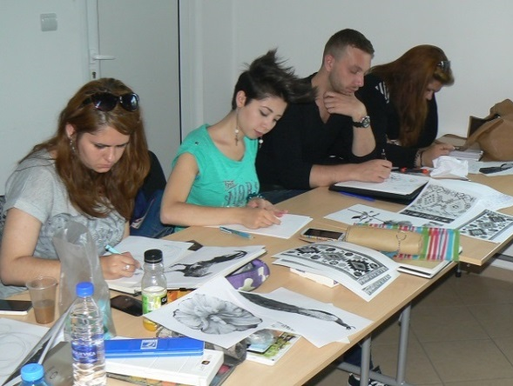
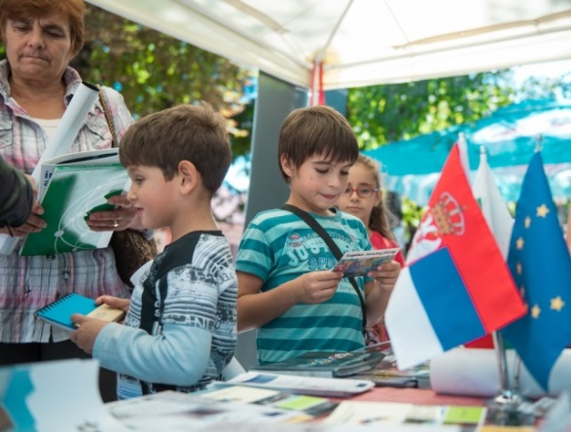
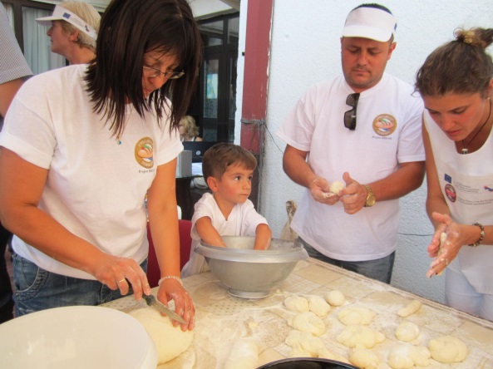
Priority Axis 2
Youths
Specific objective 2.1: Skills & Entrepreneurship;
Specific objective 2.2: People-To-People Networking.

Slide 20
Projects proposed for funding under Priority Axis 2
Financial allocation 2015 - 2017

Slide 21
Specific Objective 2.1
Reference No: CB007.1.21.343
Title: “Grounds for better future of our youth”
Brief description: The project envisages reconstruction of two playgrounds and the adjacent green areas in Martinovo and Jelezna villages and Cultural-Educational Center in Boljevac, providing youths with proper facilities for their activities and creating an attractive learning and living environment. Organization of workshops on youth entrepreneurship and elaboration of research analysis and Local Policy Guide on youth entrepreneurship are also planned.
Partners:
LP - Cultural-Educational Center Boljevac
PP2 - Municipality of Chiprovtsi
Requested budget: 514 990,20 Euro Total average score: 96.00

Slide 22
Specific Objective 2.1
Reference No: CB007.1.21.129
Title: “Development of diagnostic centres for postural and musculoskeletal disorders in school children in Serbia and Bulgaria”
Brief description: Two diagnostic centers in Knjazevac and Vidin will be developed and equipped with state-of-the-art metric technology, allowing rapid static and dynamic postural and spinal analysis. The facilities will provide non-invasive, radiation-free screening while the detected conditions will be treated by courses of corrective gymnastics. The positive results will be demonstrated during a common sports event in Vidin, while a joint conference in Knjazevac will help raising public awareness of the proliferation of pediatric PMDs.
Partners:
LP - Sports Association of Knjazevac
PP2 – Municipality of Vidin
Requested budget: 598 598,60 Euro Total average score: 94.00

Slide 23
Specific Objective 2.1
Reference No: CB007.1.21.314
Title: “Investing in Youth Capital through modernization of the Cultural centers in the cross-border region”
Brief description: The project aims to create a bond between the generations and the different ethnic groups and, together with their educational dimension, to contribute to the development of youth and their creative potential, as well as to establish cross-border youth networks. The project also envisages rehabilitation of the facilities of the community centers and development of the relationships established between the young people from both sides of the cross-border region.
Partners:
LP - Cultural Centre of Dimitrovgrad
PP2 - Community centre “G.S. Rakovski – 1928”, Dragovishtitsa, Kostinbrod Municipality
Requested budget: 449 382,92 Euro Total average score: 93.00

Slide 24
Specific Objective 2.1
Reference No: CB007.1.21.040
Title: “Investment in the health and the prosperity of youth in the Bulgarian – Serbian region”
Brief description: The project envisages development of innovative extra-curricular program in 6 professional high schools, which will help parents and teachers in Nisava and Pernik Districts to fight the constantly growing level of obesity, the lack of aspiration among high school students to continue their education, and the dropping level of the quality of education. The project will help improve sport and recreational facilities in 4 professional high schools in Crveni Krst Municipality, Nis and 2 professional high schools in Pernik.
Partners:
LP - City municipality Crveni Krst, City of Nis
PP2 - District Administration Pernik
Requested budget: 599 954,14 Euro Total average score: 92.00

Slide 25
Specific Objective 2.1
Reference No: CB007.1.21.282
Title: “Improvement of youth-related infrastructure in the cross-border region Rila-Sokobanja (Cross-Border Youth Zone)”
Brief description: The project envisages renovation of the dressing-room and the bathrooms in the Rila city stadium, restoration of the playground field, delivery and installation of sports facilities for football and basketball, and installation of a surrounding system. In Sokobanja, the project plans reconstruction of existing stadium stands and objects, rehabilitation of the main football field, reconstruction of pathways around the stadium and construction of watering and drainage system. Additionally, cross-border sport days will be organized.
Partners:
LP - Municipality of Rila
PP2 - Municipality of Sokobanja
Requested budget: 577 385,92 Euro Total average score: 92.00

Slide 26
Specific Objective 2.1
Reference No: CB007.1.21.320
Title: “Improvement of sports infrastructure as the basis for the development of young sport talents”
Brief description: The project envisages modernization and renovation of the training stadium and sports facilities in Montana and the city stadium of Vranje. After implementation of the reconstruction activities, football tournaments will be organized in both cities. Additionally, promotional materials will be elaborated and disseminated.
Partners:
LP - Municipality of Montana
PP2 - Municipality of Vranje
Requested budget: 599 845,58 Euro Total average score: 92.00

Slide 27
Projects proposed for funding under Priority Axis 2
Financial allocation 2018

Slide 28
Specific Objective 2.1
Reference No: CB007.1.21.288
Title: “Prevention of the demographic collapse in the cross-border region”
Brief description: The project aims to deliver knowledge, expertise and professional experience to young people from Pirot and Montana districts through establishment of a center for innovation and improvement of skills of young doctors in the region. This will help introducing health care career opportunities to students and stimulate interest in medical profession through health care capacity building courses. Additionally the project envisages supply of medical equipment needed for educational and demonstration purposes.
Partners:
LP - Center for social work - Pirot
PP2 - Municipality of Montana
Requested budget: 528 668,24 Euro Total average score: 91.50

Slide 29
Specific Objective 2.1
Reference No: CB007.1.21.161
Title: “Development of ‘Entrepreneurial DNA’ as a backbone of the future cross border training and business environment”
Brief description: The project envisages development and implementation of E-DNA database in order to stimulate networking between the young people, as the future entrepreneurs and workforce, with potential employers. The cross-border E-DNA Centre will consultatively support the youth within the framework of formal education institutions. The project also envisages development and implementation of internship programmes in Botevgrad and Nis, and organization of a competition within a cross-border E-DNA fair.
Partners:
LP - University of Nis
PP2 - International Business School, Botevgrad
Requested budget: 193 668,17 Euro Total average score: 90.50

Slide 30
Specific Objective 2.2
Reference No: CB007.1.22.012
Title: “Youth Riders”
Brief description: The project aims to encourage networking and partnerships between youths, youth organizations, public institutions and decision makers in the field of cross-border cooperation, and especially in the context of on-going reforms in youth-related policies in both countries. It envisages use of innovative approaches for joint analysis of youth problems and finding common solutions through joint research and organization of cross-border leader camps for young.
Partners:
LP - Free Youth Centre, Vidin
PP2 - Association for Development of Children and Youth - Open Club, Nis
PP3 - Association for local development Kamenica
Requested budget: 149 875,00 Euro Total average score: 90.00

Slide 31
Specific Objective 2.1
Reference No: CB007.1.21.030
Title: “Young entrepreneurs of today - successful people of tomorrow”
Brief description: The project aims to create conditions for improvement of professional qualifications of unemployed youths from the cross-border region and stimulation of youth entrepreneurship. It envisages: supply of equipment for an education halls in the local community centers in Peturch and Pirot; organization of training courses in Peturch and Pirot within three specific modules; and elaboration and dissemination of a bilingual guide - “Job finding and business plan preparation”.
Partners:
LP - Local community center "New life 1919“, Peturch
PP2 - SK "POBEDNIK“, Pirot
Requested budget: 189 788,04 Euro Total average score: 90.00

Slide 32
Specific Objective 2.1
Reference No: CB007.1.21.066
Title: “We invest in sport for career development of young people – the motive power of smart growth and cohesion between the Municipalities of Botevgrad and Leskovac”
Brief description: The project envisages renovation and supply of equipment for the sports hall “Balkan” and the sports hall “Arena Botevgrad”, supply of specialized equipment for sports and recreational Center “Dubucica”; elaboration of a training program and a web-based platform for monitoring of the educational training; and organization of sport events.
Partners:
LP - Municipality of Botevgrad
PP2 - Basketball club Actavis Academy, Leskovac
PP3 - Contemporary Society Foundation, Botevgrad
Requested budget: 599 820,12 Euro Total average score: 90.00

Slide 33
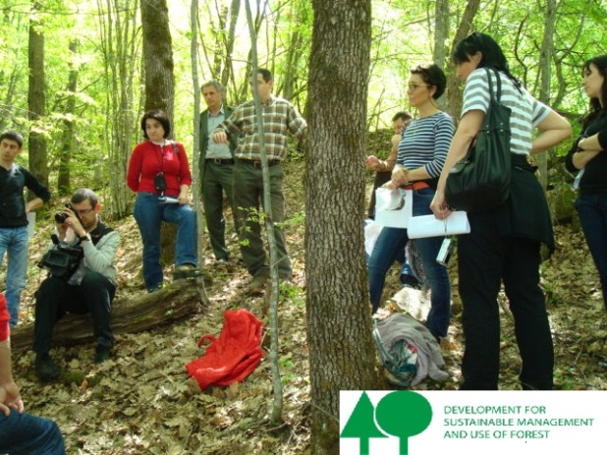
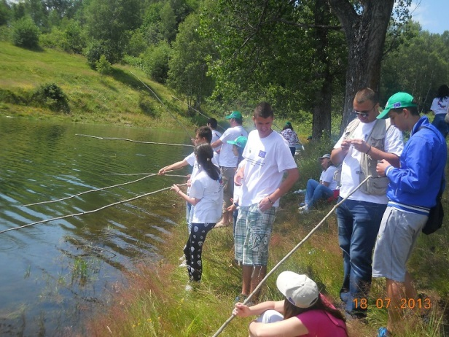
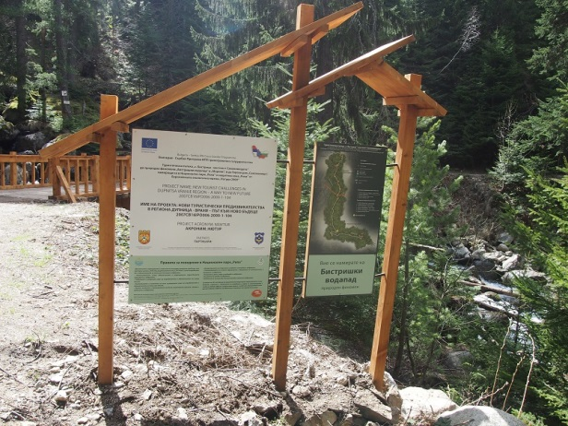
Priority Axis 3
Environment
Specific objective 3.1: Joint Risk Management;
Specific objective 3.2: Nature Protection.

Slide 34
Projects proposed for funding under Priority Axis 3
Financial allocation 2015 - 2017

Slide 35
Specific Objective 3.2
Reference No: CB007.1.32.224
Title: “Clean and Green Life”
Brief description: Project is focused on improving municipal waste management through: provision of modern waste collection equipment; exchange of know-how and adoption of the best EU practices into a joint action plan for waste management in the Kula-Knjazevac region; organization of round table discussions and public debates; carrying out joint cross-border eco initiative "My Green Home“; and a joint school campaign on ecological issues.
Partners:
LP - Municipality of Kula
PP2 - Public Utility Company "Standard" - Knjazevac
Requested budget: 599 507,17 Euro Total average score: 95.00

Slide 36
Specific Objective 3.1
Reference No: CB007.1.31.126
Title: “Joint Training Programme for Forest Fire Prevention and Management”
Brief description: The project aims to ensure high-level of preparedness, closer cooperation, and exchange of know-how in the field of forest fire prevention and management through: procurement of specialialized equipment (firefighting vehicle, laboratory equipment, simulation training software); renovation of emergency centres; development of joint training program; elaboration of a common strategy for forest fire management and forest fire maps for 2 pilot areas in the region; conduction of trainings and field visits in Nis, Pernik and Kyustendil districts.
Partners:
LP - Academy of the Ministry of Interior, Sofia
PP2 - Directorate General Fire Safety and Civil Protection – Ministry of the Interior, Sofia
PP3 - University of Nis, Faculty of Occupational Safety in Nis
Requested budget: 597 099,91 Euro Total average score: 94.00

Slide 37
Specific Objective 3.1
Reference No: CB007.1.31.217
Title: “Joint management of risks in the region - Niska Banja and Kostenets”
Brief description: The project will help improve the effectiveness of the local risk management units in Niska Banja and Kostenets through: procurement of high performance emergency equipment for prevention and mitigation of disasters; organization of a seminar for sharing experiences in fighting with disasters; organization of a roundtable on common risk management; development of a joint action plan; performance of joint exercises and training for simulating cross-border disaster in Niska Banja and Kostenets.
Partners:
LP - Municipality of Niska Banja
PP2 - Municipality of Kostenets
Requested budget: 591 642,35 Euro Total average score: 94.00

Slide 38
Specific Objective 3.1
Reference No: CB007.1.31.287
Title: “Joint prevention and mitigation of the consequences of natural and man-made cross-border disasters in the municipalities of Svoge and Merosina”
Brief description: The project aims developing a joint system for management of natural and man-made disasters in the municipalities of Svoge and Merosina through: performance of joint risk assessment and preparation of plans and procedures for emergency situations; supply of specialized firefighting equipment and equipment for flood prevention and search and rescue operations; conduction of joint theoretical-tactical exercises and field trainings for emergency management; conduction of study visits and exchange of know-how.
Partners:
LP - Municipality of Svoge
PP2 - Municipality of Merosina
Requested budget: 599 222,95 Euro Total average score: 93.00

Slide 39
Specific Objective 3.1
Reference No: CB007.1.31.316
Title: “Reducing flooding related risk through rehabilitation of flood protection infrastructure in Dupnitsa and supply of specialized equipment for floods prevention in Gadzin Han”
Brief description: The project aims to: repair and rehabilitate the flood protection infrastructure in Dupnitsa; procure specialized equipment for flood prevention in Gadzin Han; reduce the risk of flooding related damages to urban territories; and enhance cross-border cooperation in prevention and management of climate related risks.
Partners:
LP - Municipality of Dupnitsa
PP2 - Public Enterprise Directorate for Construction and Communal Affairs of the Municipality of Gadzin Han
Requested budget: 599 975,20 Euro Total average score: 91.50

Slide 40
Specific Objective 3.1
Reference No: CB007.1.31.304
Title: “Prevention and mitigation of consequences of man-made cross-border disasters in the region Vidin-Zajecar”
Brief description: The project is focused on preventing and mitigating effects from natural and man-made cross-border disasters in Vidin and Zajecar districts through: procurement of specialized equipment; exchange of experience in the field of waste collection; development of detailed research on the cross-border impact from unregulated dumps on the territory of Vidin and Zajecar; cleaning of unregulated dumping sites in both municipalities.
Partners:
LP - Municipality of Vidin
PP2 - City of Zajecar
Requested budget: 550 499,32 Euro Total average score: 91.00

Slide 41
Projects proposed for funding under Priority Axis 3
Financial allocation 2018

Slide 42
Specific Objective 3.2
Reference No: CB007.1.32.318
Title: “Preservation and improvement of the environment in the cross-border region through composting of biodegradable waste”
Brief description: The project is directed at environmental change adaptation through: carrying out waste composting studies and needs assessment in Vidin and Bor districts; supply of composting equipment; organizing capacity building event for local/regional decision-makers and other stakeholders; development of cross-border plan for management of biodegradable waste; performance of cross-border assessment of the composting effect.
Partners:
LP - “Bulgaria in Europe” Association, Vidin
PP2 - Kladovo Municipality
Requested budget: 152 780,19 Euro Total average score: 89.50

Slide 43
Specific Objective 3.1
Reference No: CB007.1.31.348
Title: “Forest Fire Fighters”
Brief description: The project aims to improve disaster management and emergency preparedness for suppressing forest fires in the region through: increasing available volunteer potential; development of GIS System for early forest fire detection and disaster risk management; development of a common strategy and action plan for joint prevention and emergency intervention actions in forest fires; conduction of fire fighting training courses for volunteers and school visits in Kula and Boljevac.
Partners:
LP - Municipality of Boljevac
PP2 – Municipality of Kula
PP3 - Association for Civilian Crisis Management, Sofia
Requested budget: 597 373,97 Euro Total average score: 89.50

Slide 44
Specific Objective 3.2
Reference No: CB007.1.32.361
Title: “Joint cross border initiatives for creation of eco friendly region”
Brief description: The project envisages: preparation of a study on fish species threatened with extinction and biodiversity conditions in Montana region; research and analysis of biodiversity preservation in Stara Planina (Pirot region); construction of an educational eco mountain camp; supply of special equipment for nature field research; establishment of a hatchery for endemic fish species in Montana region; elaboration of a programme for protection of rare river species; development of joint action plan for protection of soil, air and water in Stara Planina mountain.
Partners:
LP - Association "Technological Institute of Aquaculture”, Montana
PP2 – Municipality of Pirot
PP3 - Centre for Development Support and Initiative “Novitas“, Pirot
Requested budget: 567 542,25 Euro Total average score: 89.50

Slide 45
Specific Objective 3.1
Reference No: CB007.1.31.247
Title: “Joint emergency interventions in Serbian and Bulgarian cross-border region”
Brief description: Project is focused on decreasing the effects of floods, landslides and other natural and man-made disasters through: elaboration of a training programme for flood rescue and management; elaboration of standard operational procedure for joint actions in the cross-border region; elaboration of a joint response plan and joint field exercise scenario; conduction of a seminar for the local authorities on the coordinated flood response and management; conduction of a joint field demonstration; supply of specialized equipment.
Partners:
LP - Sector for Emergency Management - Ministry of Interior, Serbia
PP2 – Directorate General Fire Safety and Civil Protection - Ministry of Interior, Bulgaria
Requested budget: 599 276,45 Euro Total average score: 89.00

Slide 46
Specific Objective 3.1
Reference No: CB007.1.31.189
Title: “Improvement of the capacity for risk management in case of major forest fires in the cross-border region - coordination, training, observation, innovative methods and equipment”
Brief description: The project aims to enhance the capacity for response of fire and safety services in cases of forest and field fires in the cross-border region through organizing a training centre for wildfires extinguishing; elaboration of a training programme for fighting forest fires; elaboration of a standard operational procedure; elaboration of a plan for joint actions and preparation of a scenario for field exercise in the cross-border region; supply of specialized equipment.
Partners:
LP - Directorate General Fire Safety and Civil Protection, Ministry of Interior, Bulgaria
PP2 - Sector for Emergency Management, Ministry of Interior, Serbia
Requested budget: 597 747,36 Euro Total average score: 89.00

Slide 47
The reserve lists
The project proposals received at least 65 points at the Technical and Quality assessment, for which funding is unavailable, to be placed in the reserve lists.
Depending on the availability of funds, projects from the reserve lists can be proposed for financing, based on the pre-contracting procedures and the approval by the JMC.

Slide 48
Thank you for your attention!
www.ipacbc-bgrs.eu

